Slide 1

Going Paperless …
Sales Complete System Overview

Slide 2
Today’s topics ….
How to get paid
Why so hard?
How bad was it?
The solution
Results
Next steps

Slide 3

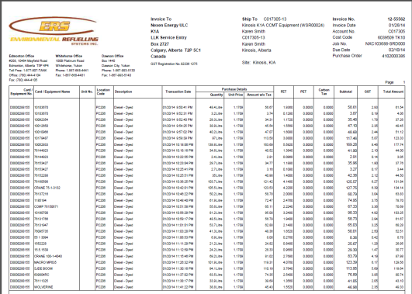

How to get paid
Backups
30 days (or so) ….
Invoice

Slide 4
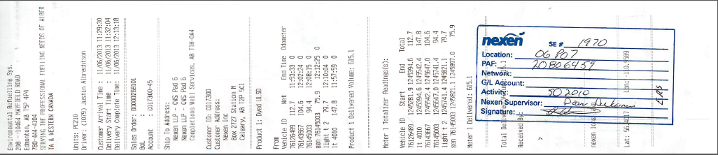
Backup Example:
Sales Order D268101

Slide 5
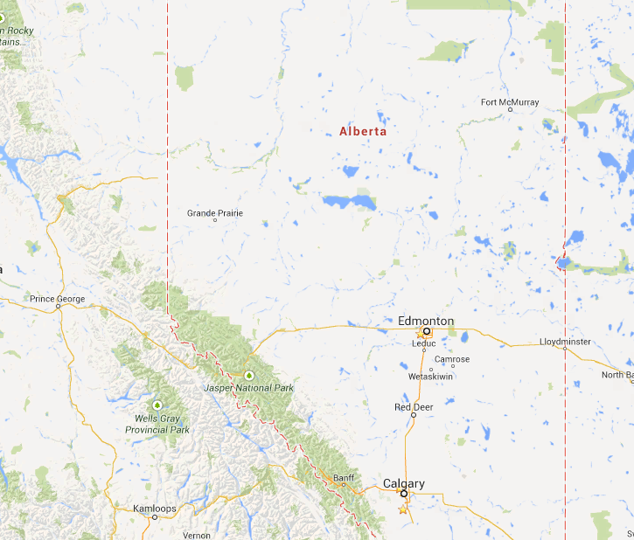
Why so hard ? ….
Fuel here
Prepare here
Remote sites, Huge distances
Thousands of deliveries
Every customer unique
Submit here

Slide 6

Painful paper cuts …
Smart Truck
NAV
Invoice to customer
CDS
SO
DSD
check ‘n chase
Email, photo,superB
days, weeks, months

Slide 7
How bad?
Unbilled sales
Feb 5 2013
$7.2M
Unbilled sales
Feb 28 2013
$3.9M

Slide 8

The Sales Complete System
Smart Truck
NAV
Invoice to Nexen
SO
DSD
Classifier
check ‘n chase
Completeness and Matching
Repository
Customer rules

Slide 9
Demonstrations …
Scan and Classify
Match documents
Documents to invoice

Slide 10
Results: Invoice ready at Nexen
2014:
50% orders
5 days
2013:
50% orders
10 days
5 days

Slide 11
Results: People
 | Previous HDOH | This HDOH
Document Control | 2 + people | 1-2
Temporary help | 1-2 + | … ?
Overtime | Lots | Any?
Unbilled sales
Feb 28 2013
$3.9M
Unbilled sales
Feb 28 2013
$0

Slide 12
Next Steps…

Slide 13
Better performance
Customer
Laggards
Target
Internal improvements

Slide 14
Questions?

Slide 15
But invoicing no faster
ST to NAV
Invoice created
5 days

Slide 16
Significant improvement at Cenovus
2014 invoice ready
2013 invoice ready-ish
4 d

Slide 17
Seismic
Days to invoice ready
Target: 2 days
Delivery Date

Slide 18
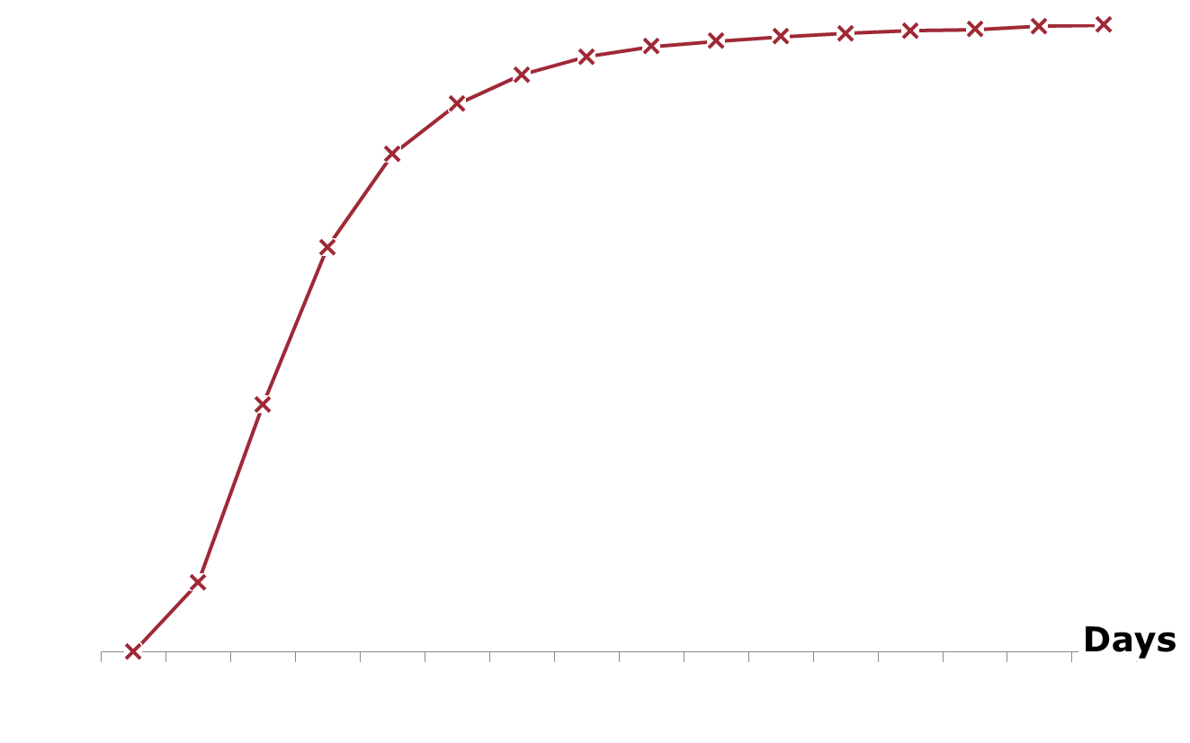
Results at Nexen
5 days
2013 invoice ready-ish

Slide 19
Seismic return trips
No ticket signed(10 x)
Days to invoice ready
Ticket signed
Delivery
Delivery Date

Slide 20
Cenovus Narrows Camp
Delivery
Nov 4
Not signed
Nov 9
Signed
Nov 16
Delivery
Jan 5
Jan 9
Jan 17

Slide 21
K1A (CDS)
Days to invoice ready
Target: 2 days
Delivery Date

